Slide 1

Welcome to the EAGE Annual Hackathon
Opening Session

Slide 2



Thank you to our sponsors who made this possible!
Supported by

Slide 3
Photography and recording
Disclaimer – if you do not want your photo taken in person in Vienna, please email the facilitators asap.
This session will be recorded – if you have not received a consent form please email the facilitators asap.

Slide 4
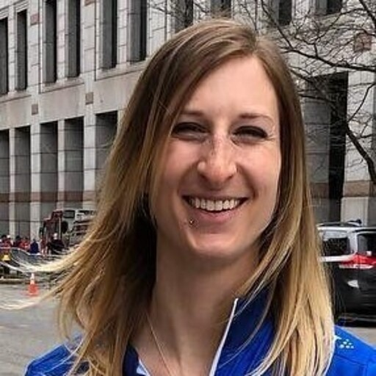

Meet your facilitators – Ashley, Lukas, Oleg and Jan
Ashley Russell (Equinor ASA)
Leader for Data Science and Analytics for subsurface in Equinor. Geologist, self taught data scientist, expertise in Python, data visualization, including interactive plotting and dashboarding, statistics, and machine learning.
@ashleyr (softwareunderground) aruss@equinor.com
Lukas Mosser (Aker BP ASA)
Lukas Mosser is an Advanced Data Scientist at Aker BP. He currently leads Aker BPs efforts around conversational AI. Lukas received his P.h.D from Imperial College London, where he worked on stochastic reconstruction of porous media and geophysical inverse problems using deep learning. He currently also serves as a member of the EAGE AI committee.
@porestar (twitter) @lmoss (softwareunderground) lukas.mosser@akerbp.com

Slide 5
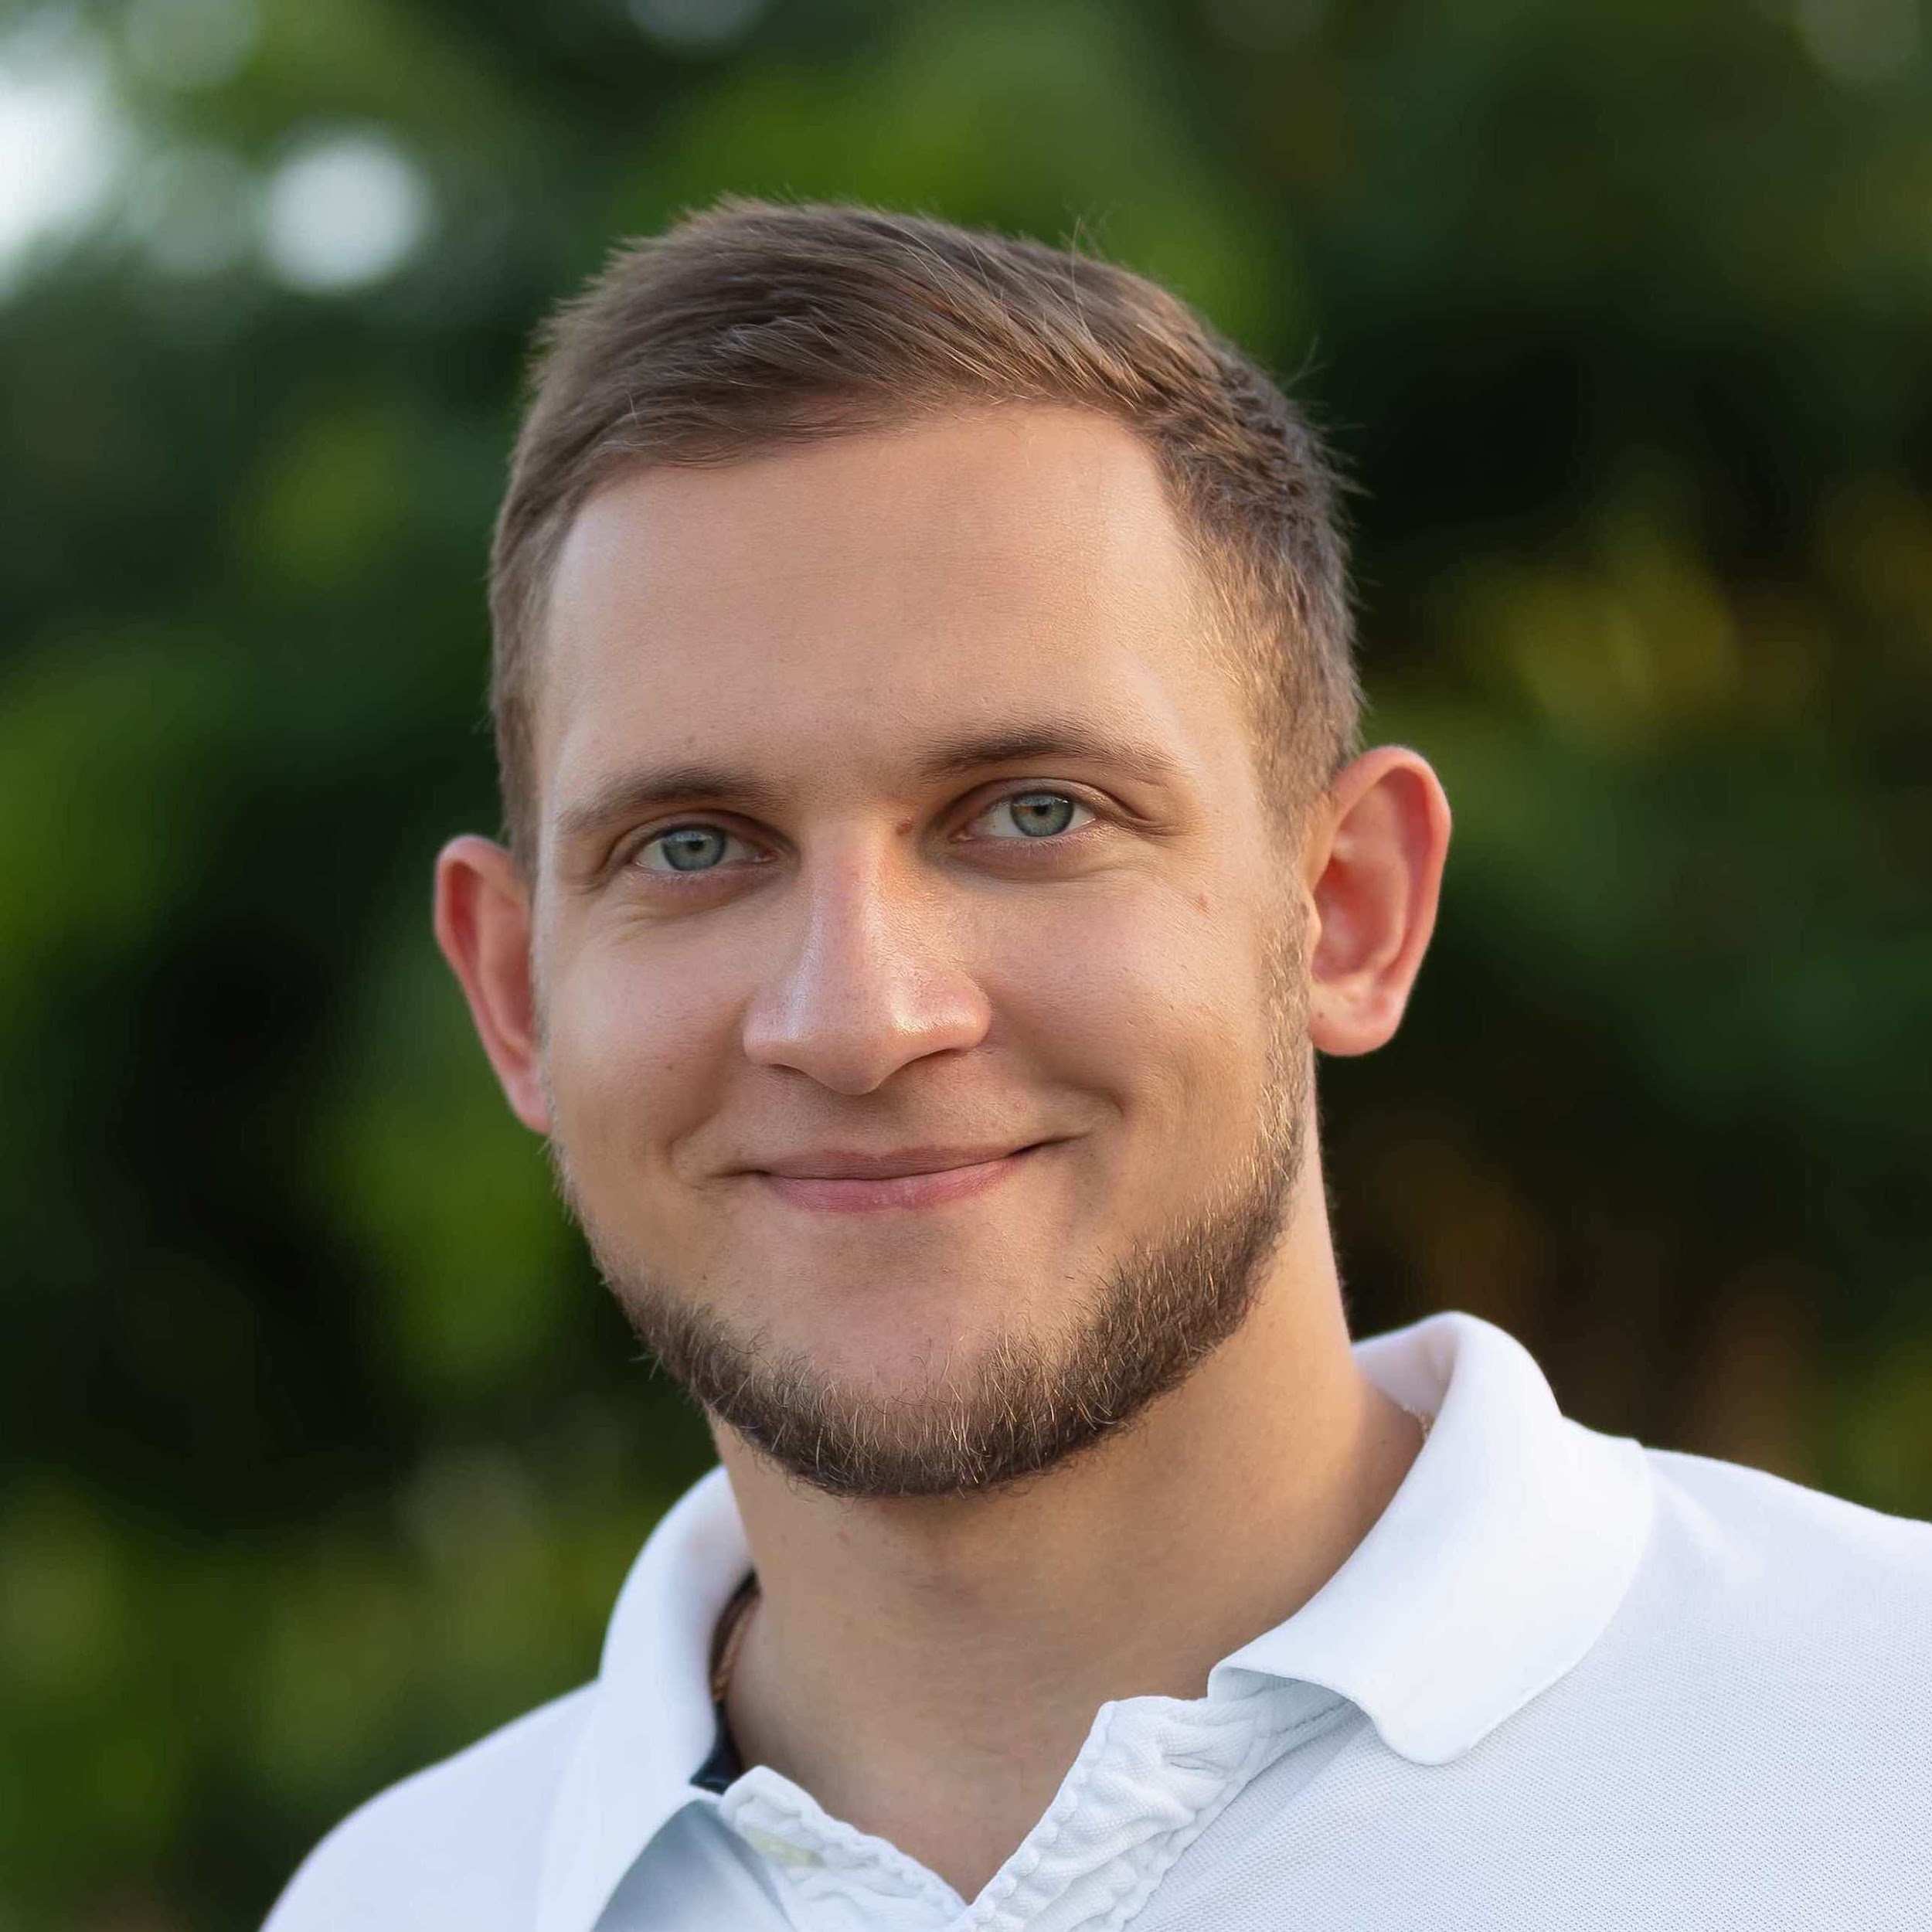
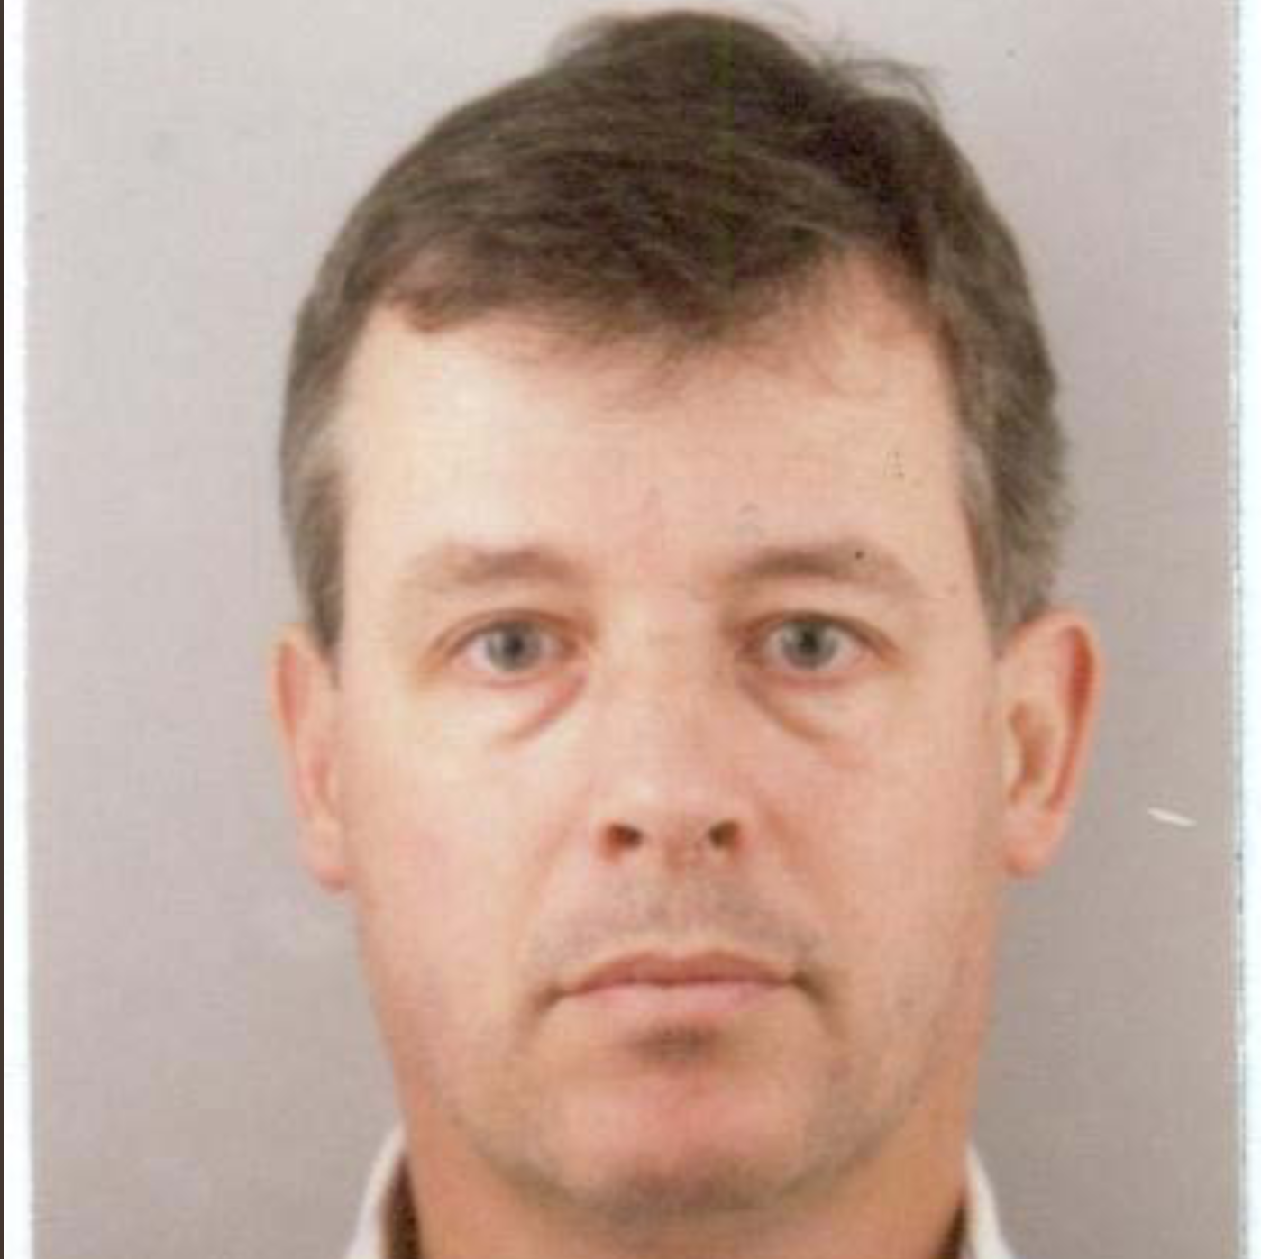
Meet your facilitators – Ashley, Lukas, Oleg and Jan
Oleg Ovcharenko (NVIDIA)
Oleg is Solutions Architect for Energy at NVIDIA. He received his Ph.D from KAUST where he was exploring data-driven methods for the initialization of full-waveform inversion. Oleg is broadly interested in HPC and deep learning applications in geophysics.
Jan van de Mortel (Independent)
Graduated MSc Geophysics in 1988 at the University of Utrecht. After 3 years of freelance work mainly in Far East joined Schlumberger in 1991 until 2011 performing various roles in surface and borehole seismic and quantitative interpretation. Joined Weatherford in 2011 until 2016, managed borehole seismic in Asia Pacific, worked as Region Geophysicist and later as Region Manager in Consulting and Data Services, in Kuala Lumpur and Dubai. Worked for a startup company 2017 to early 2019 specializing in Machine Learning applications in Dubai. Currently working independently as a consultant with main attention in Machine Learning applied to Geosciences

Slide 6
Agenda
Day 1: Sunday, June 4
Day 2: Monday, June 5
9:00 - 9:30 CEST - Welcome and coffee 9:30 - 10:30 CEST – Introduction Plenum Session 10:30 – 11:00 CEST – Project and team discovery time 11:00 - 18:00 CEST - Hacking all day
9:00 - 9:15 CEST - Welcome and coffee 9:15 – 12:00 CEST - Hacking 12:00 CEST: CODE FREEZE – Join online session to receive final presentation criteria (Jitsi) 12:15-14:00 CEST – Time for working and practicing presentations 14:00 – 15:15 CEST - Presentations to the Judging Panel 15:15 - 15:45 CEST - Announcement of the winners and prizes*

Slide 7
Awards!
There are two awards up for grabs.
These two teams will have their final presentations in the AI special session during the annual meeting!
The winners will also be awarded free access codes for self-paced online courses from NVIDIA Deep Learning Institute
“Best in Show”
A panel of judges will join us for the presentations on the last day and will award this prize.
“Audience Choice”
Each hacker will vote for their favorite team (not their own) and the team with the most votes wins this one!

Slide 8
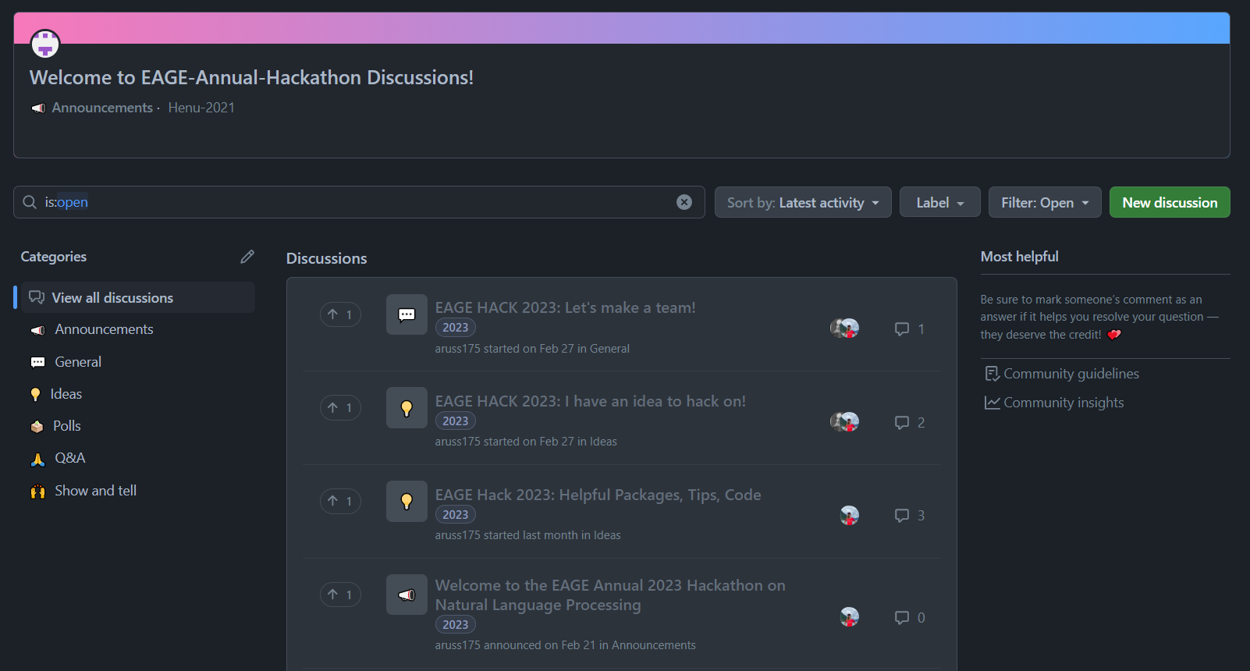
Github is our main tool during the hack
EAGE – Annual – Hackathon - Discussions

Slide 9
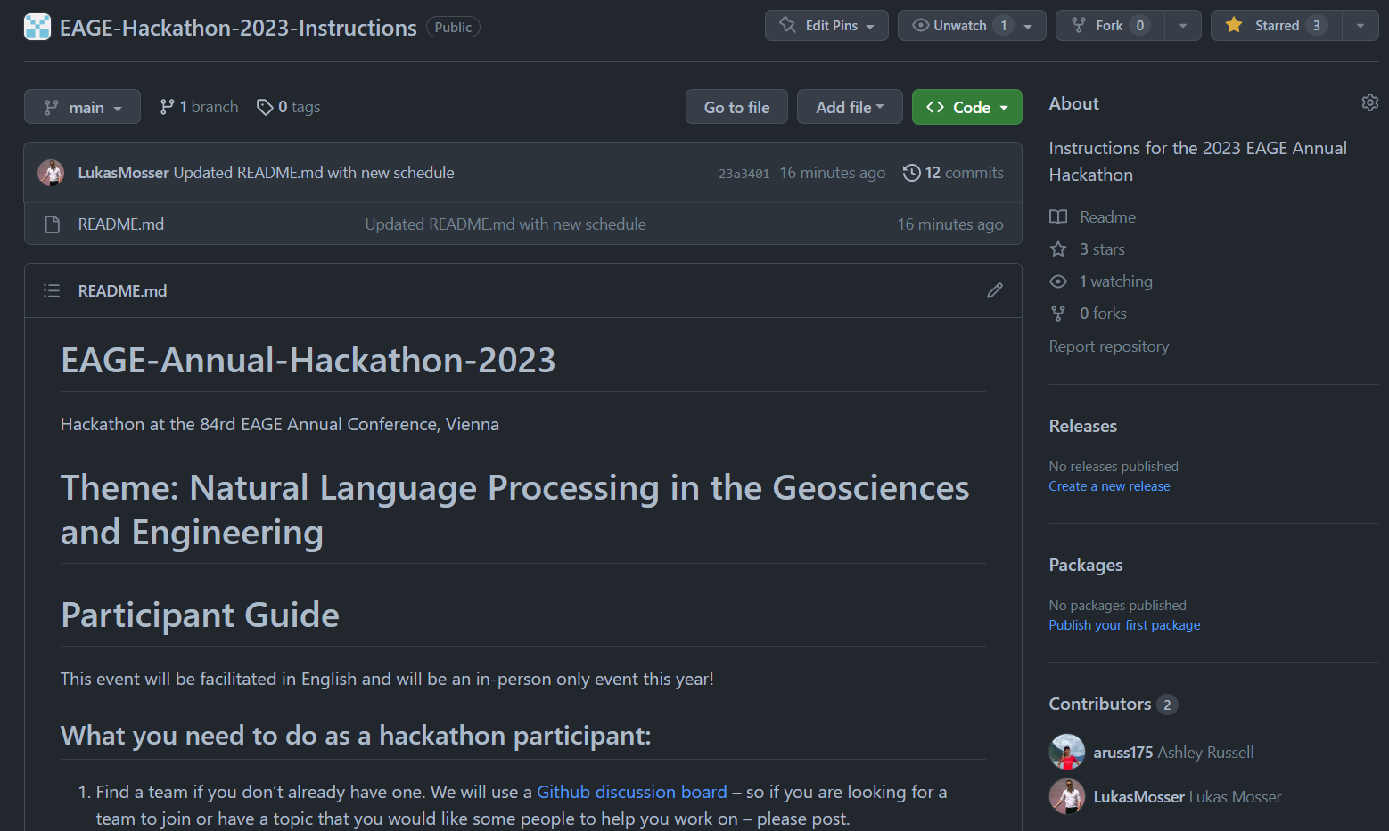
Github Hackathon Instructions
EAGE – Annual – Hackathon - Instructions

Slide 10
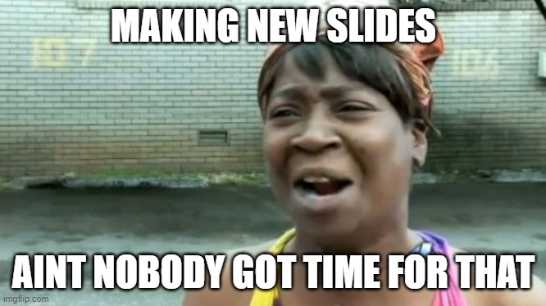
Introduction to NLP
(Body)

Slide 11
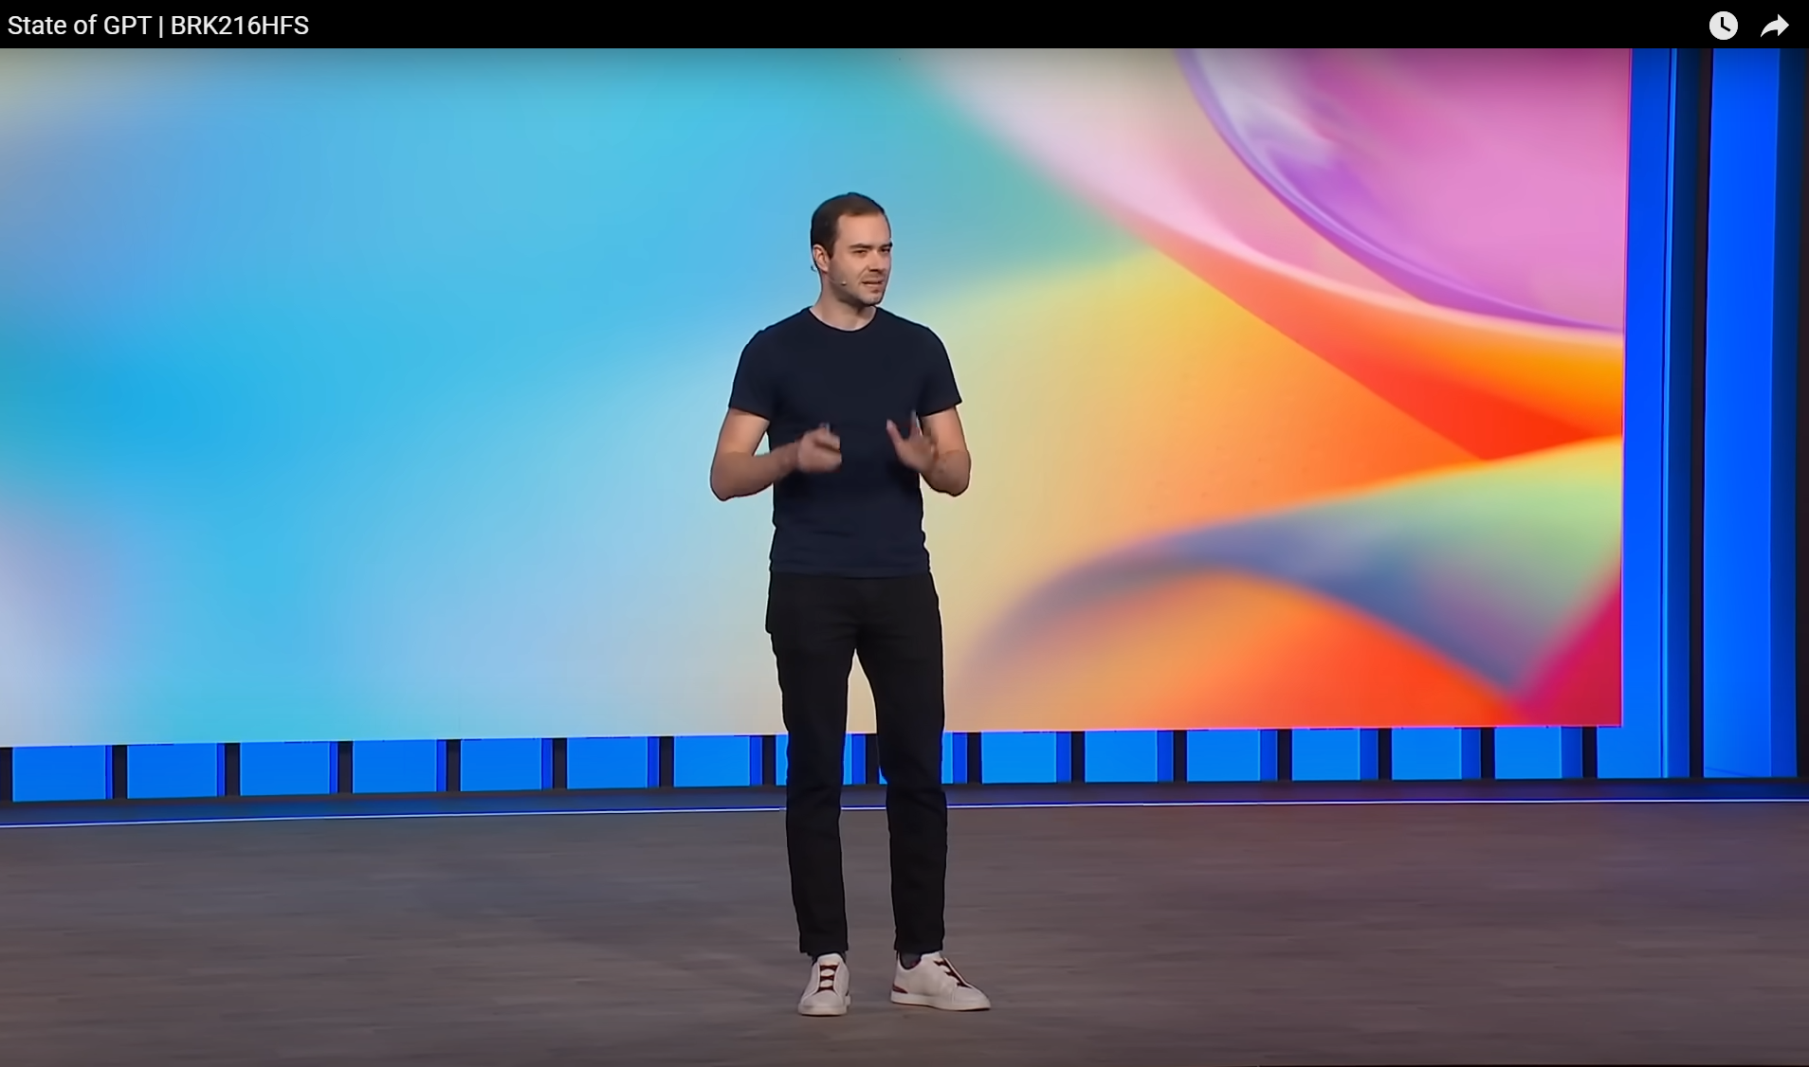

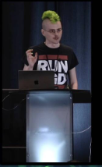
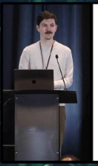
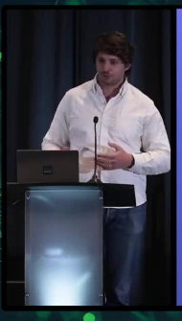
(Title)
(Body)
Charles Frye, Sergey Karayev, Josh Tobin
Andrej Karpathy a.k.a. the GOAT
State of GPT – Microsoft Build 2023

Slide 12
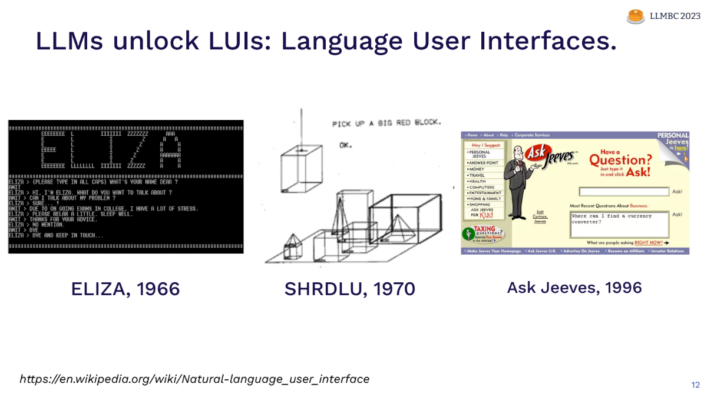
(Title)
(Body)

Slide 13
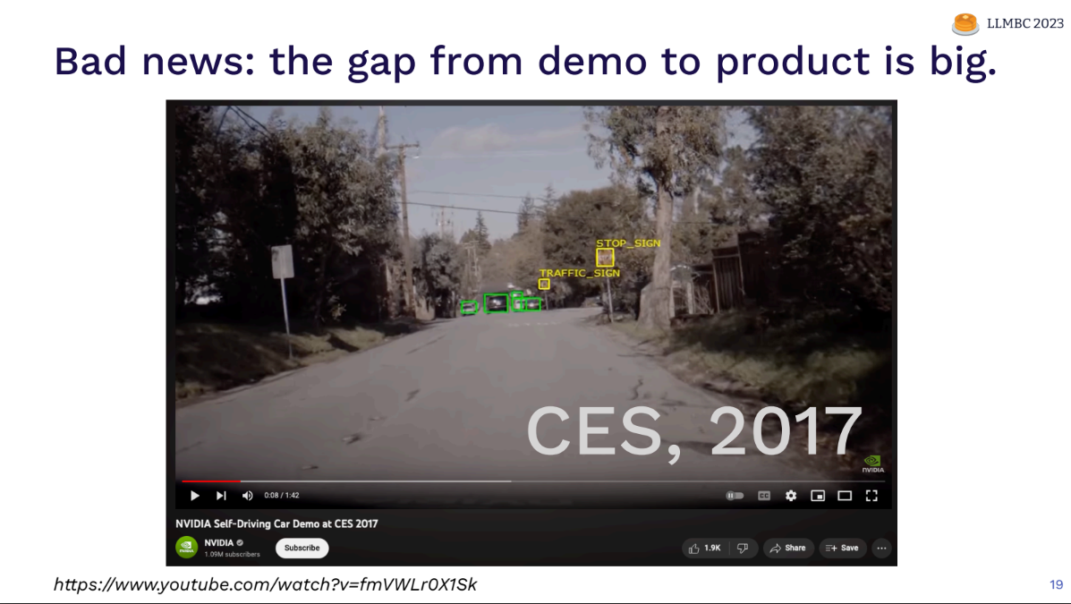
(Title)
(Body)

Slide 14
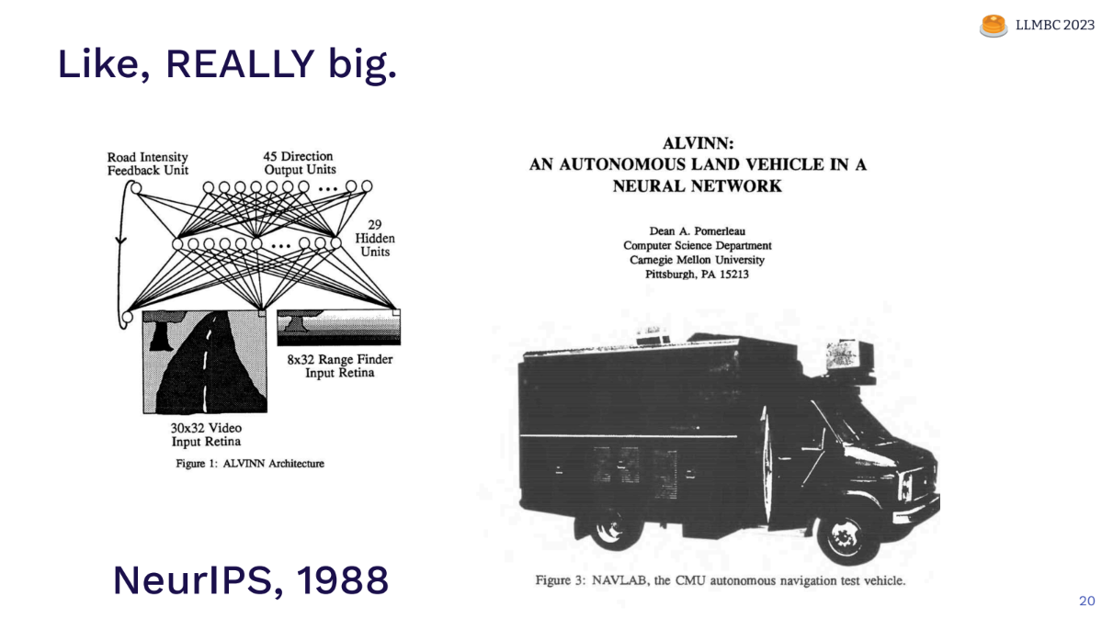
(Title)
(Body)

Slide 15
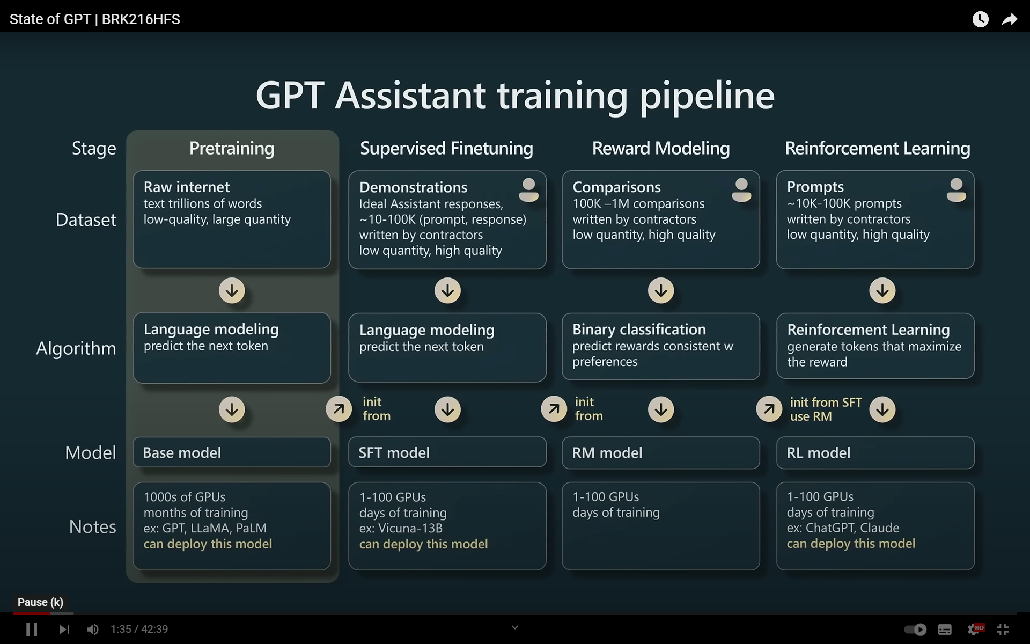
(Title)
(Body)

Slide 16
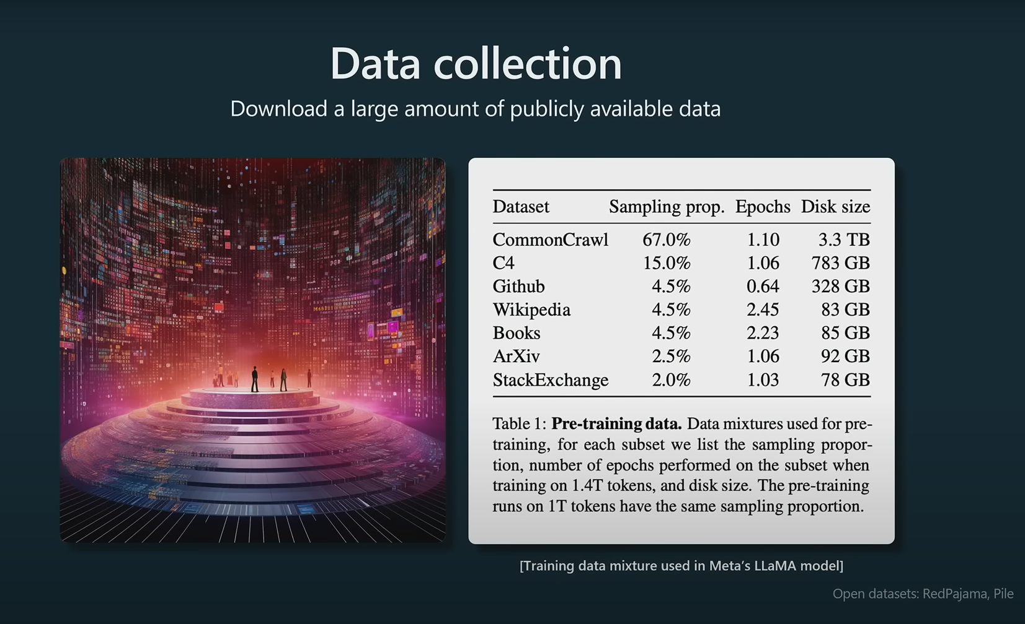
(Title)
(Body)

Slide 17
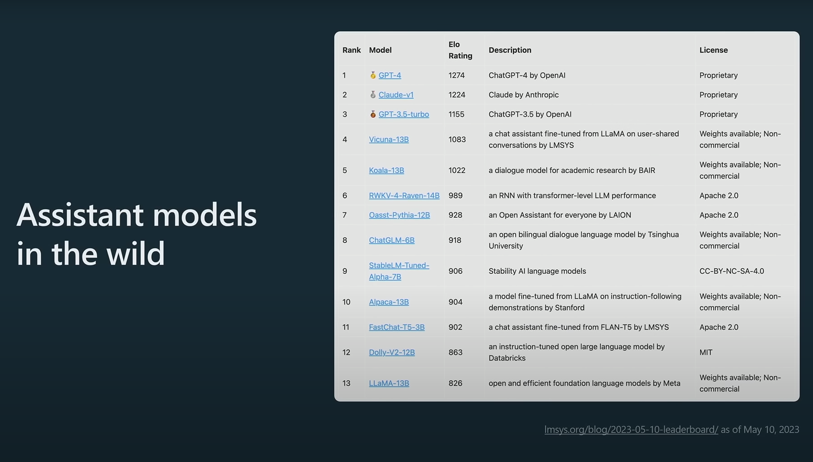
(Title)
(Body)

Slide 18
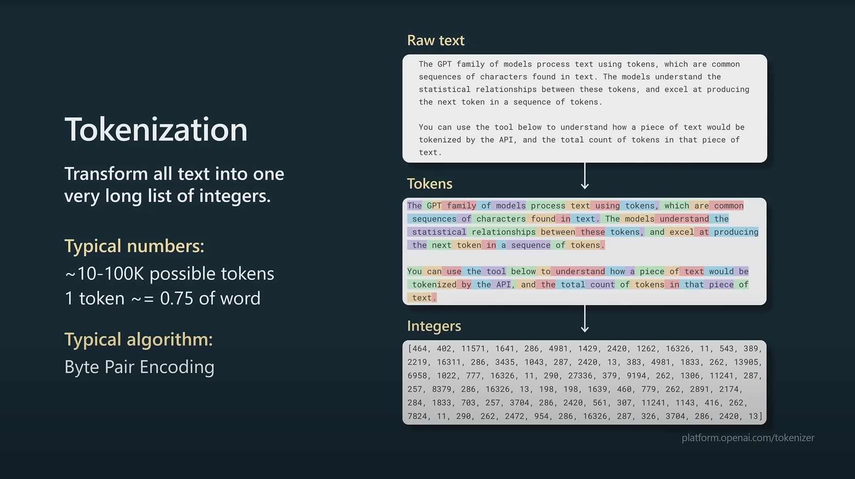
(Title)
(Body)

Slide 19
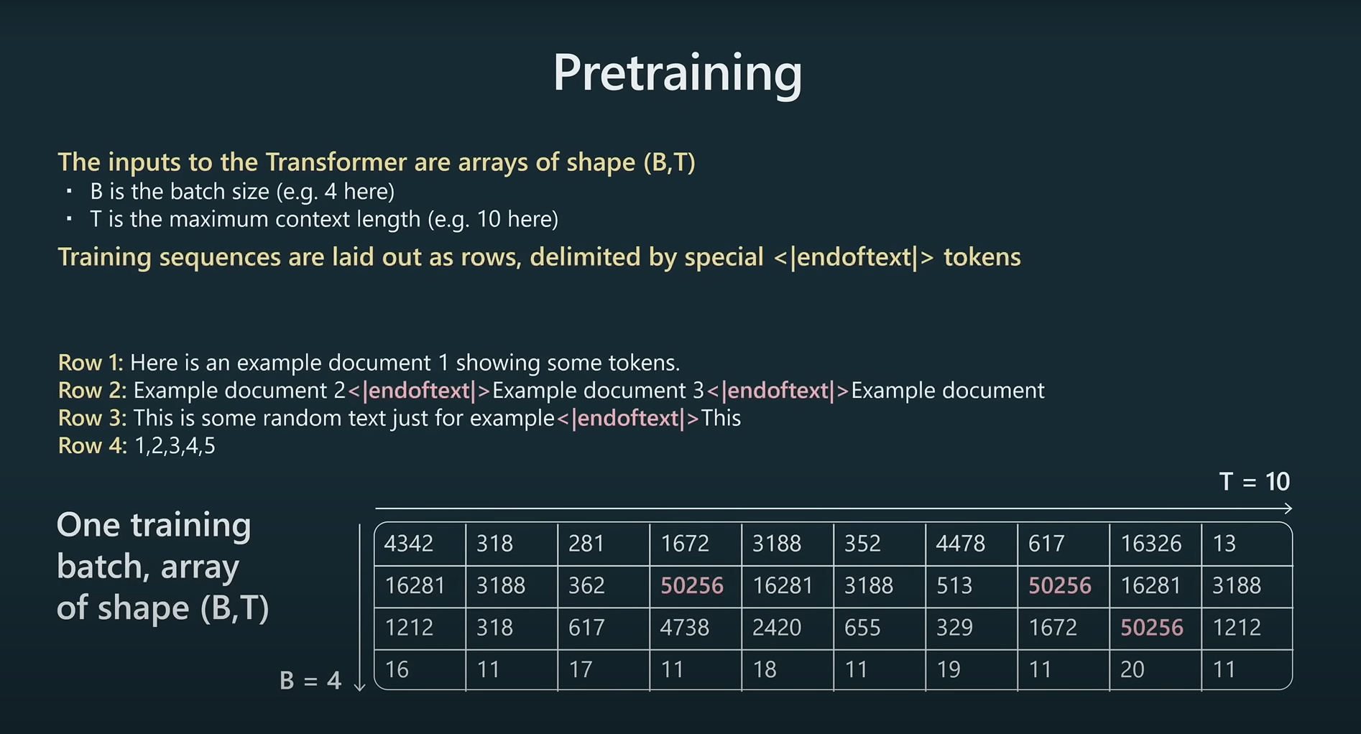
(Title)
(Body)

Slide 20
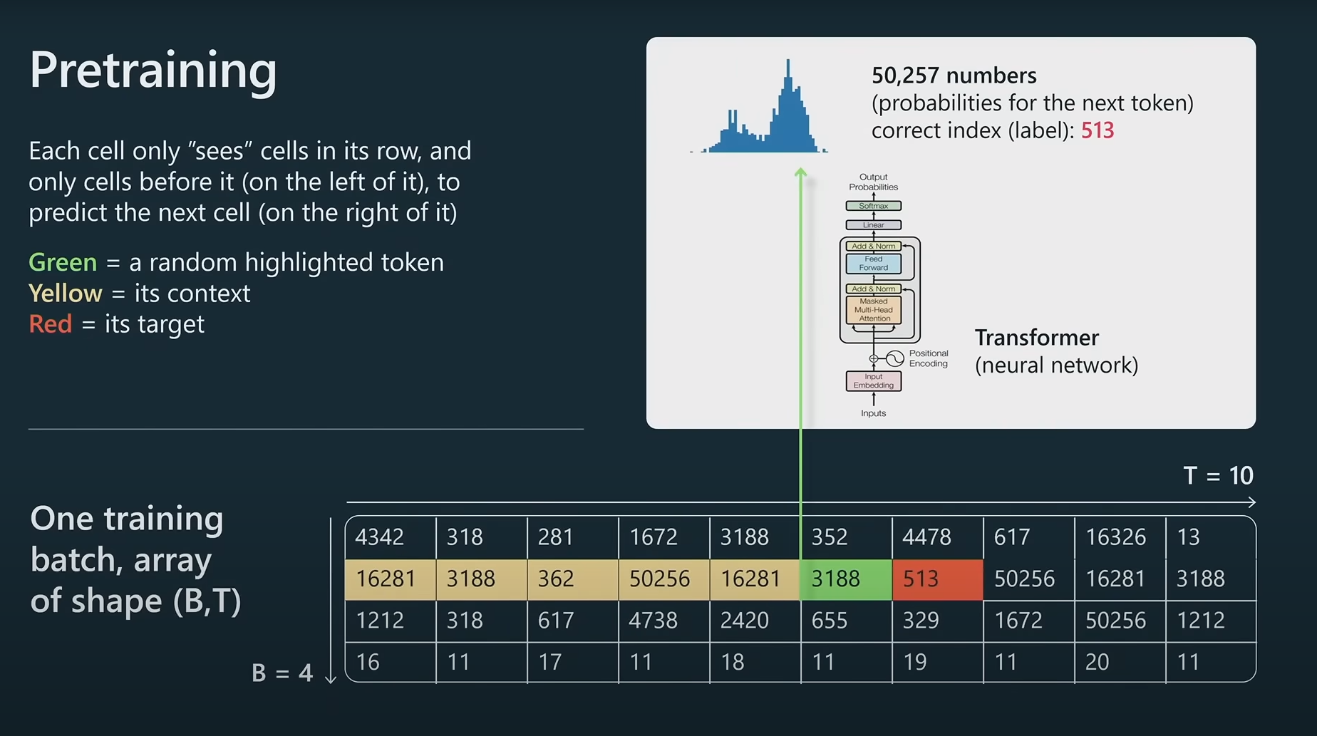
(Title)
(Body)

Slide 21
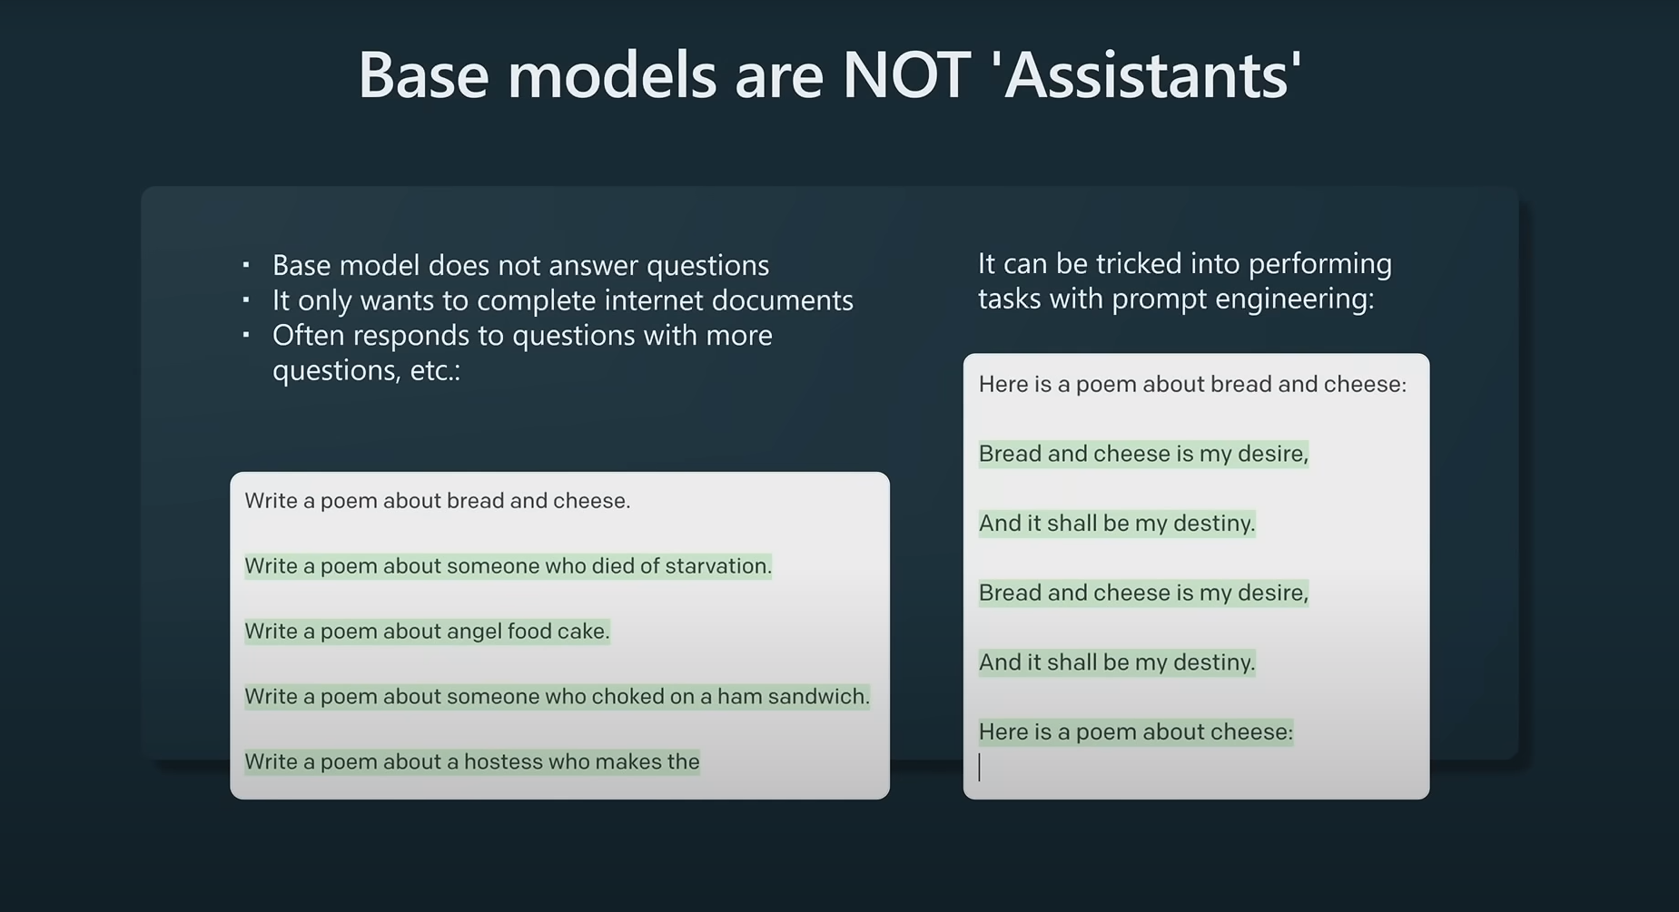
(Title)
(Body)

Slide 22
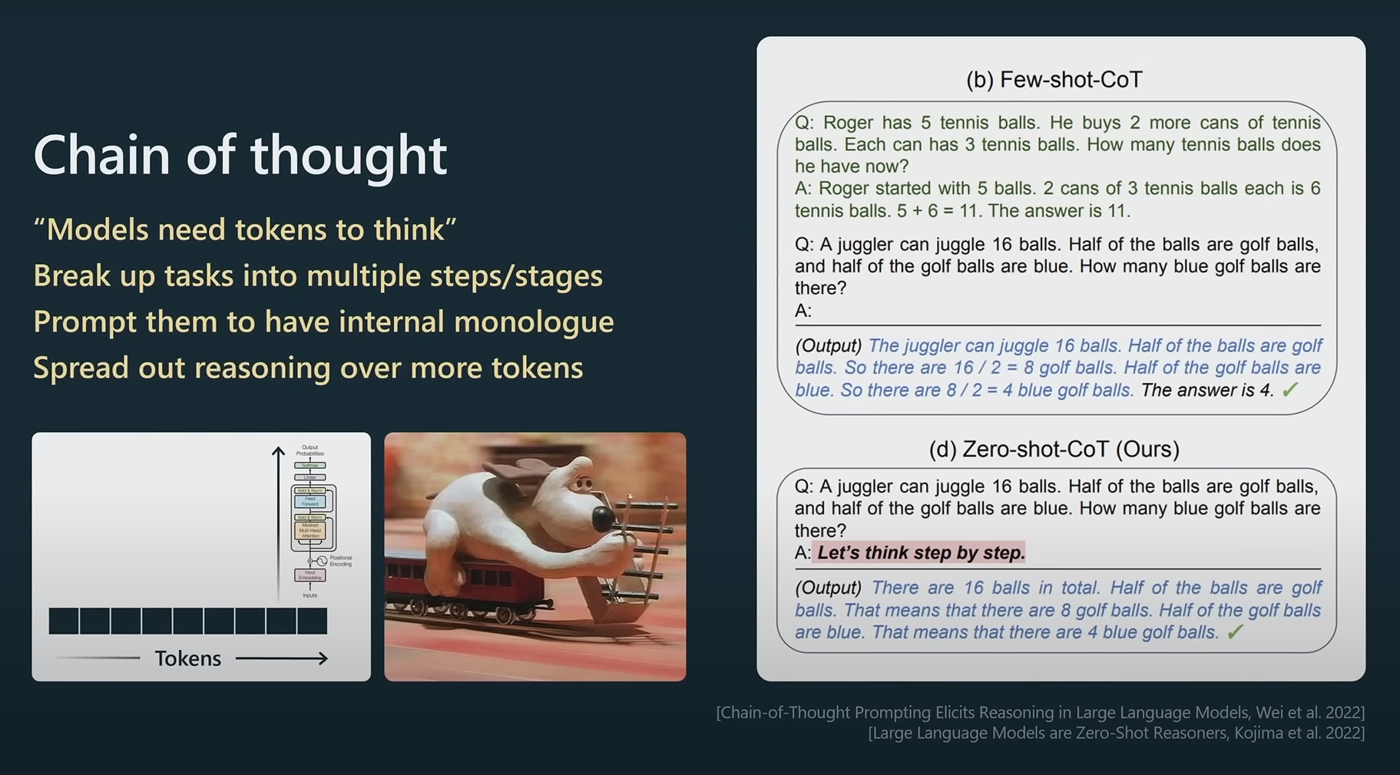
(Title)
(Body)

Slide 23
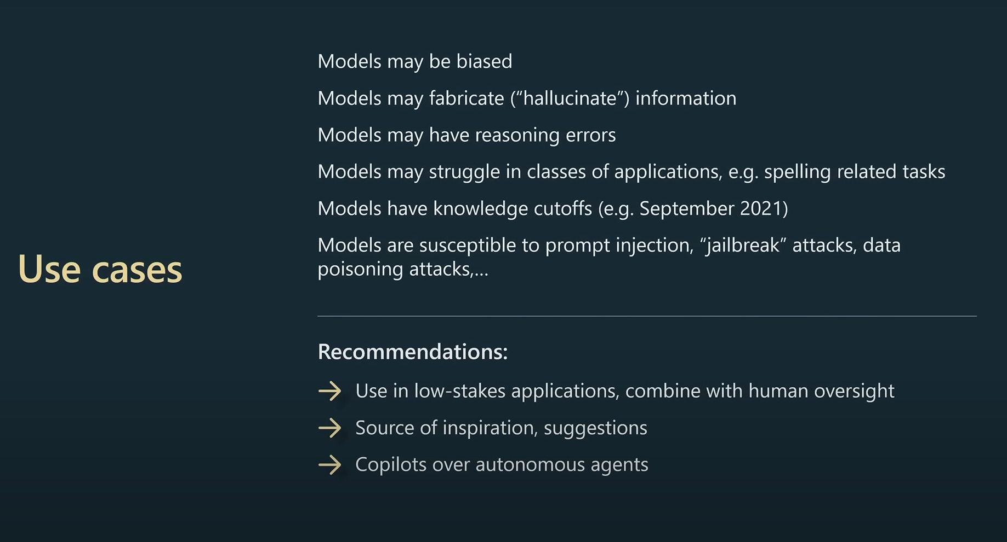
(Title)
(Body)

Slide 24
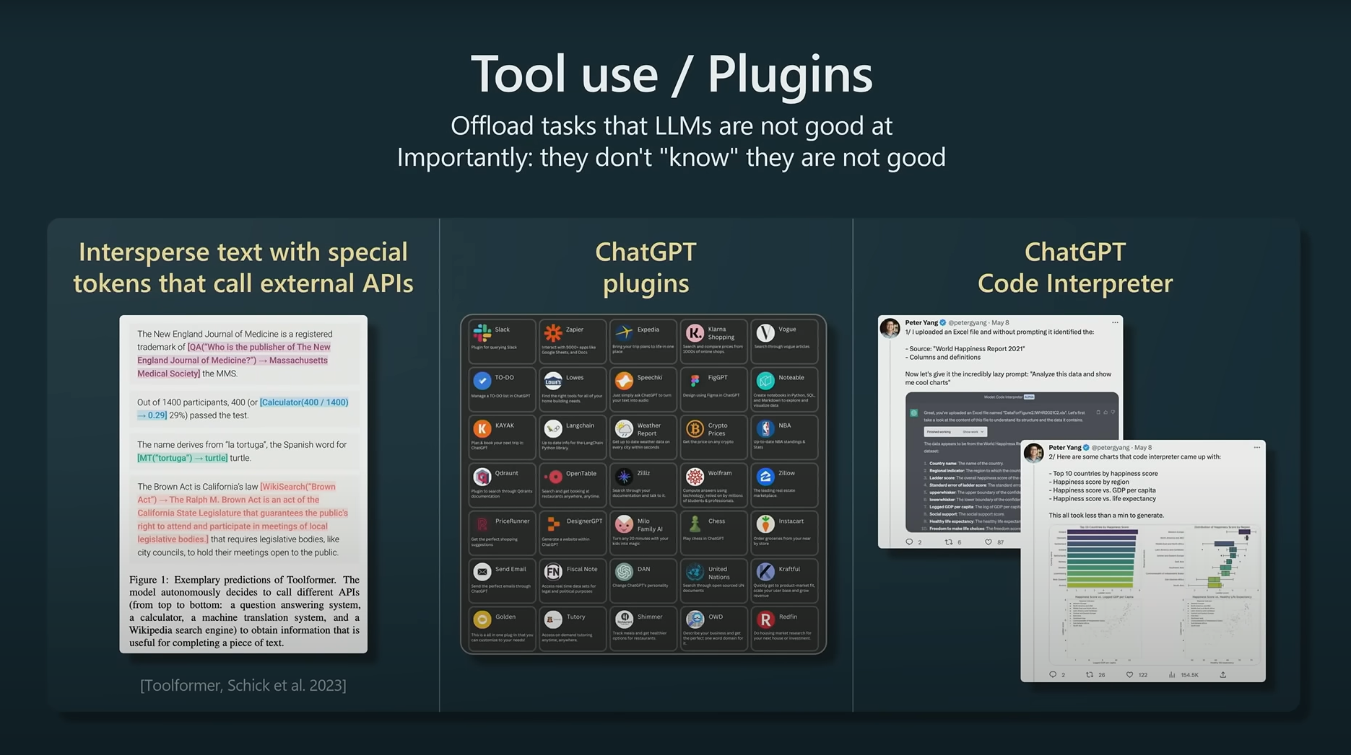
(Title)
(Body)

Slide 25
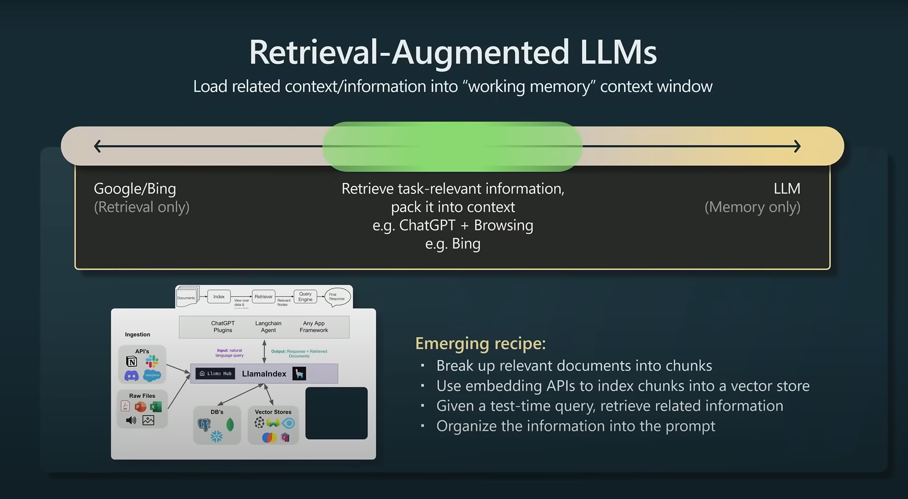
(Title)
(Body)

Slide 26
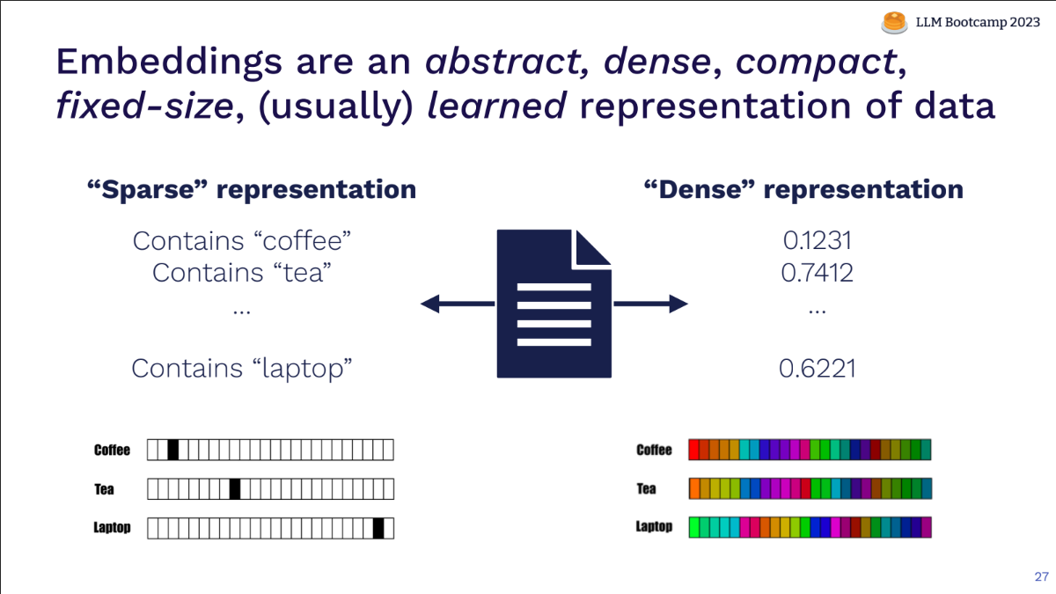
Resources

Slide 27
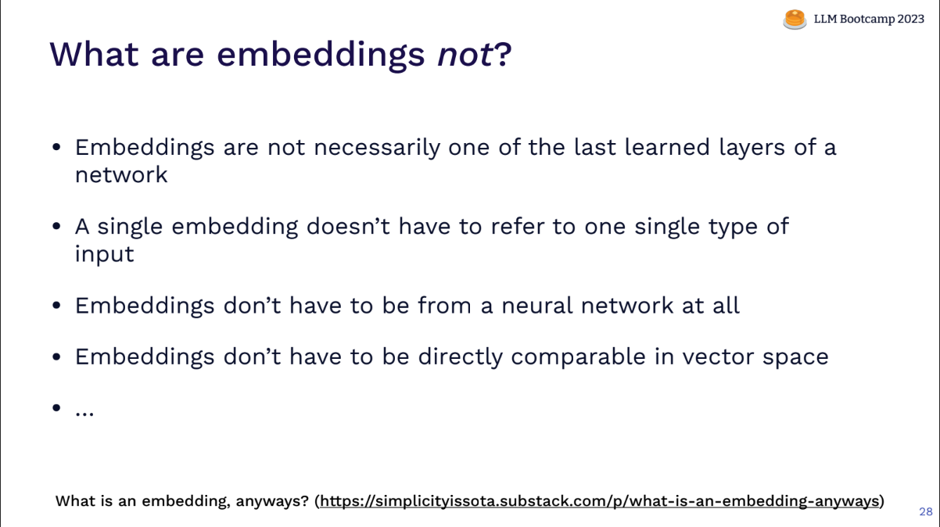
Resources

Slide 28
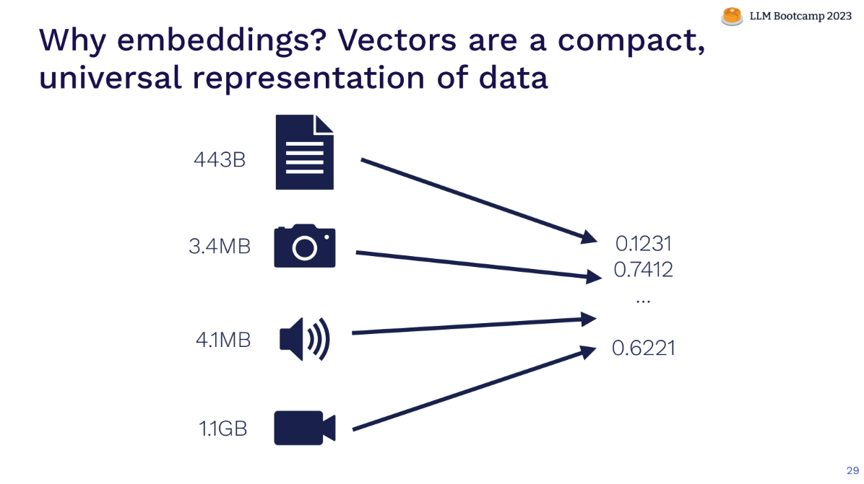
Resources

Slide 29
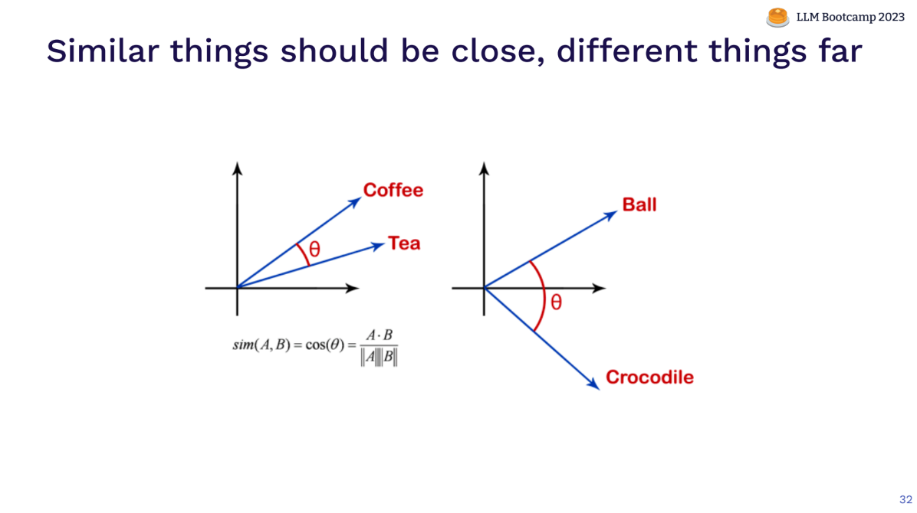
Resources

Slide 30
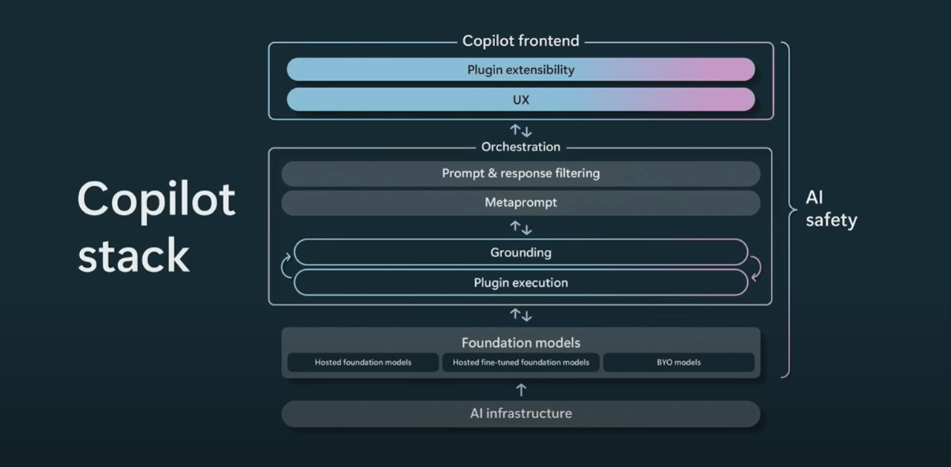
(Title)
(Body)

Slide 31
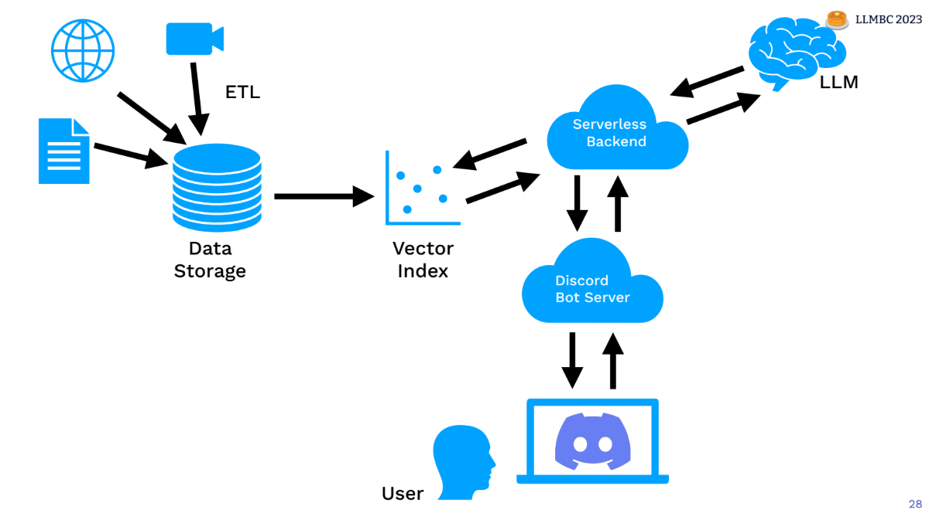
Example Chat-Bot Architecture
(Body)

Slide 32
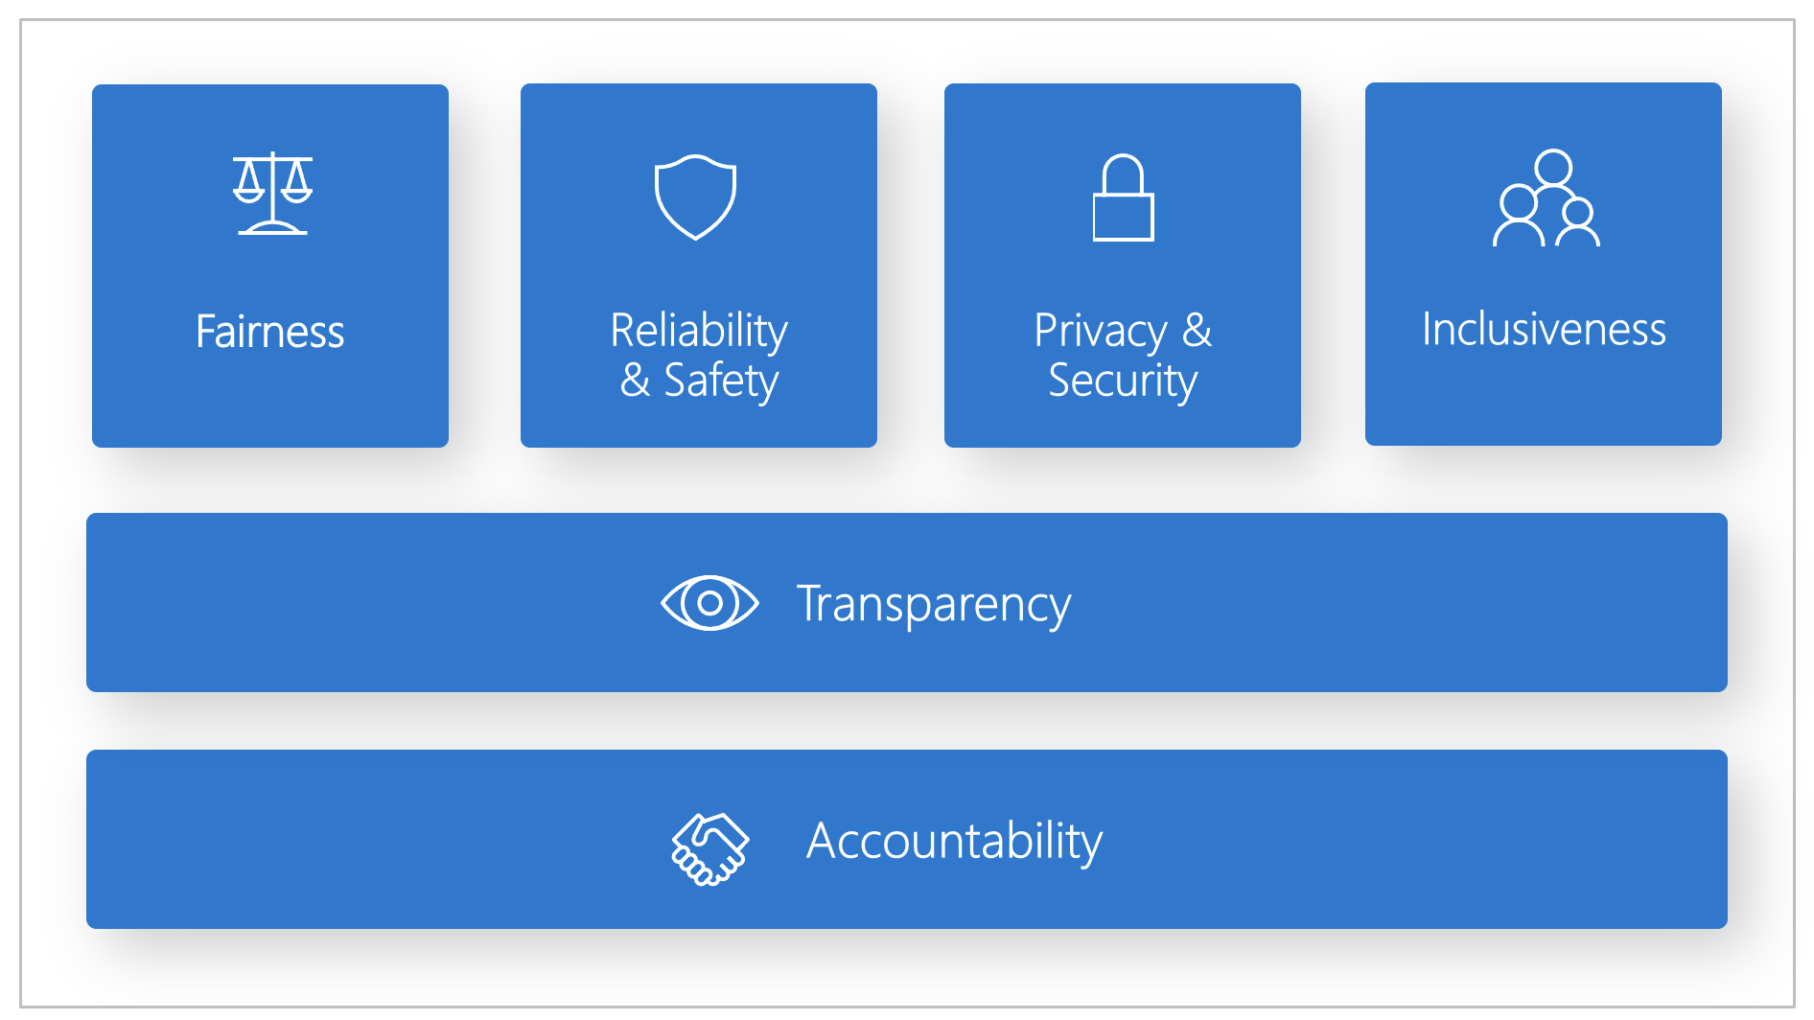
Responsible AI Framework(s)
(Body)

Slide 33

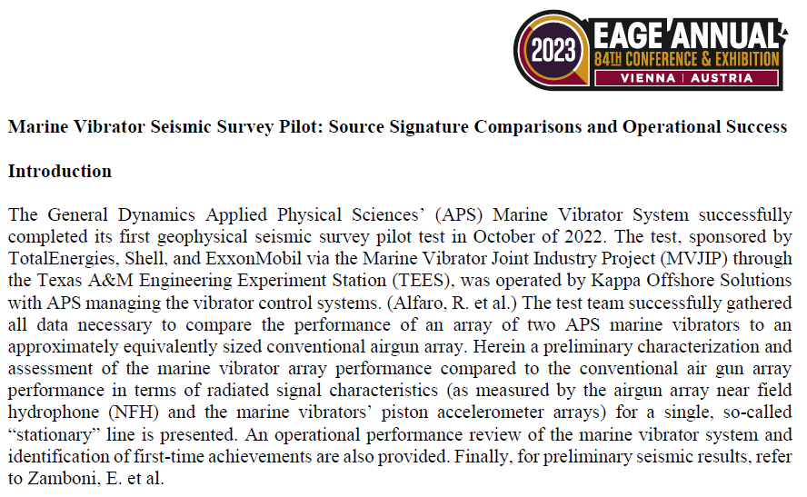
API Restrictions
(Body)
The response was filtered due to the prompt triggering Azure OpenAI’s content management policy. Please modify your prompt and retry.

Slide 34
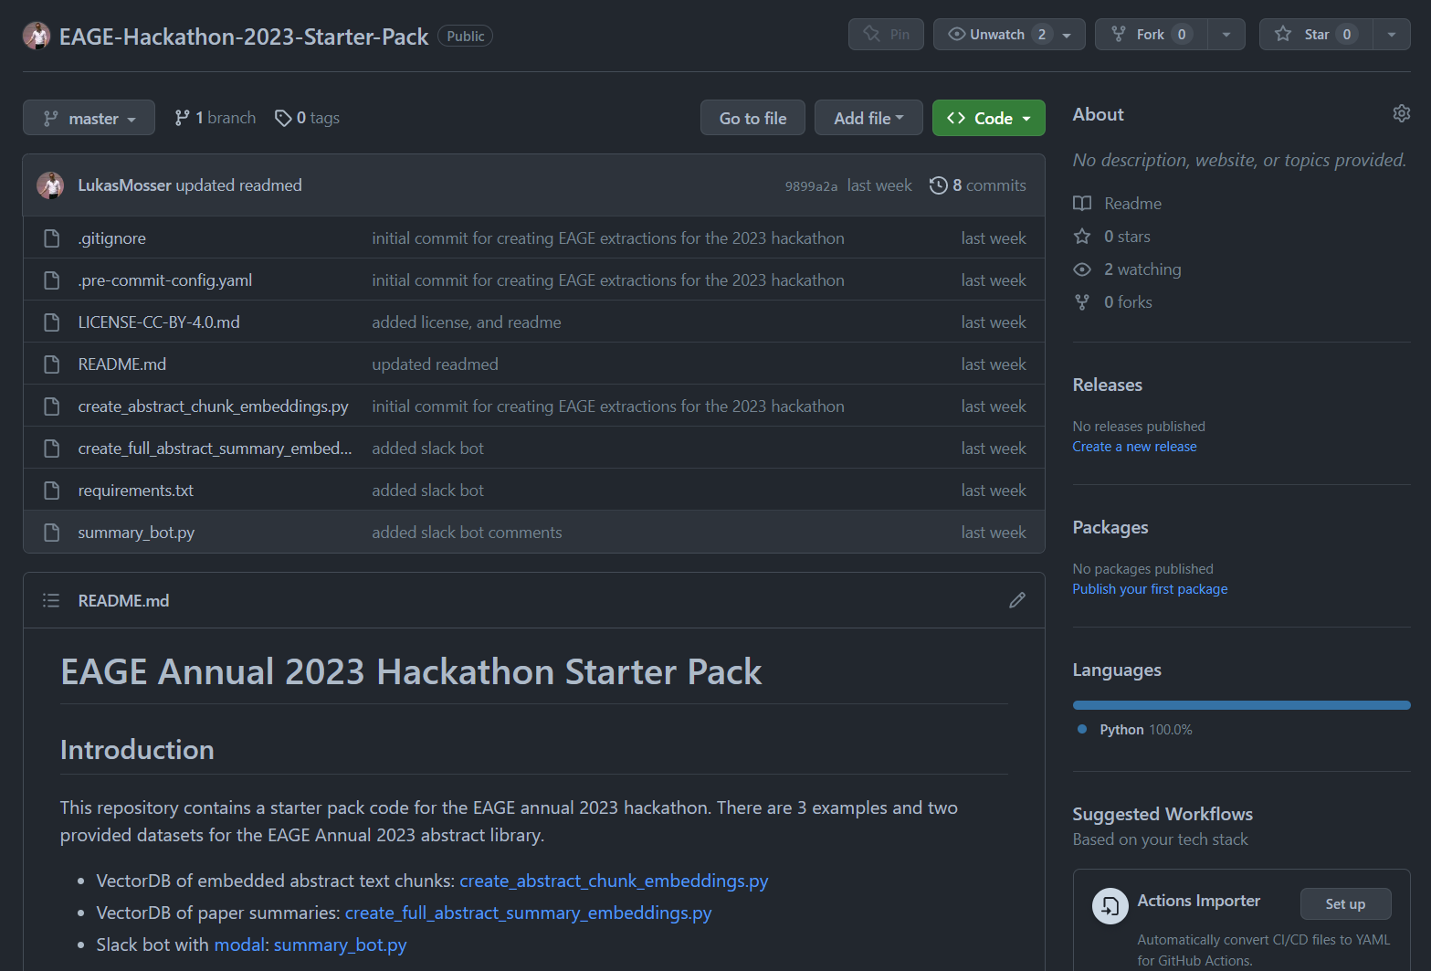
Hackathon Starter Pack
EAGE – Annual – Hackathon – Starter Pack

Slide 35
Starter Pack
879 Papers of the EAGE Annual – Thanks EAGE!
Vector Database of (nearly) all Paper Summaries
Vector Database of Chunks of Papers
Script for creating a slack chatbot (Modal Labs)
No linked meta-data (missing titles, authors, etc)
Notes:
188, 620, 642, 829, gave issues

Slide 36
Resources
OpenAI APIs – Text Models, ChatGPT & Embeddings
Huggingface Modelhub
Langchain: Agents, Chains, Tools, etc
LlamaIndex:
OpenAI Code Examples
EAGE Hackathon Starter Pack
Google Drive with all papers / EAGE Repository w. all papers
Google Drive pre-computed VectorDBs
Slack Channel (build your own bot)
Modal Labs (30$ for free, no credit card)

Slide 37
Resources
FullStack LLM Bootcamp 2023
State of GPT – Microsoft Build 2023
The era of the AI copilot – Microsoft Build 2023
Augmented Language Modes – LLM Bootcamp

Slide 38
Some General Recommendations
Be mindful towards others and yourself.
Ask for help
Interact with other teams
Try to close the loop early: data -> model -> interpretability -> learnings
One key item, is better than 100 half-baked things
Focus on things that will get your idea across
Keep it simple, s**** (KISS)
Get to know your teammates, play into your strengths
Maximize learning, over winning. Learning *is* winning.
Presentation is key
Dare to go your own way: Every hackathon, project, team, and individual are unique.
Source: Accumulated Hackathon Experience

Slide 39
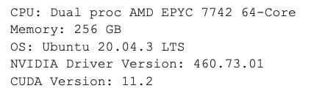
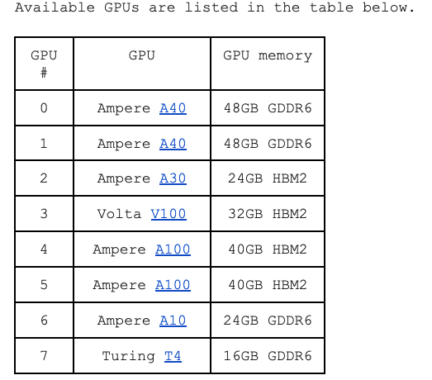
GPU resources
Connect to login node:
ssh you_login@nvpoc.ddnsfree.com
Run interactive session:
srun --gpus N --pty bash -i
NVIDIA Docker Container Repository
https://catalog.ngc.nvidia.com/
Full details:
https://docs.google.com/document/d/1ce94uqAhiggMm9IQvgMElNZiI-T3XDTklsjPcpcv0qA/edit?usp=sharing

Slide 40
Some Hackathon Tips
Take screenshots as you go along – this will save a lot of time when you come to preparing the final presentation
A little planning goes a long way – post its to organize your work or making a list can help keep focus. For those online try using a Jamboard (https://jamboard.google.com/) or Github Issues
By the end of the day today you should have settled on a specific case, sketched out a plan, and have started some work.

Slide 41
Reminder: Hackathons aren’t about getting a perfect solution or answer – it is about trying something new, being bold and learning along the way ☺

Slide 42
Hackathon Project Ideas
Make a Dataset
Train your own GPT
Sentiment Analysis on EAGE Papers?
Entity recognition and knowledge graphs
Make an EAGE Chatbot
Just learn to code – NLP as a tool to get started!
Much much more

Slide 43
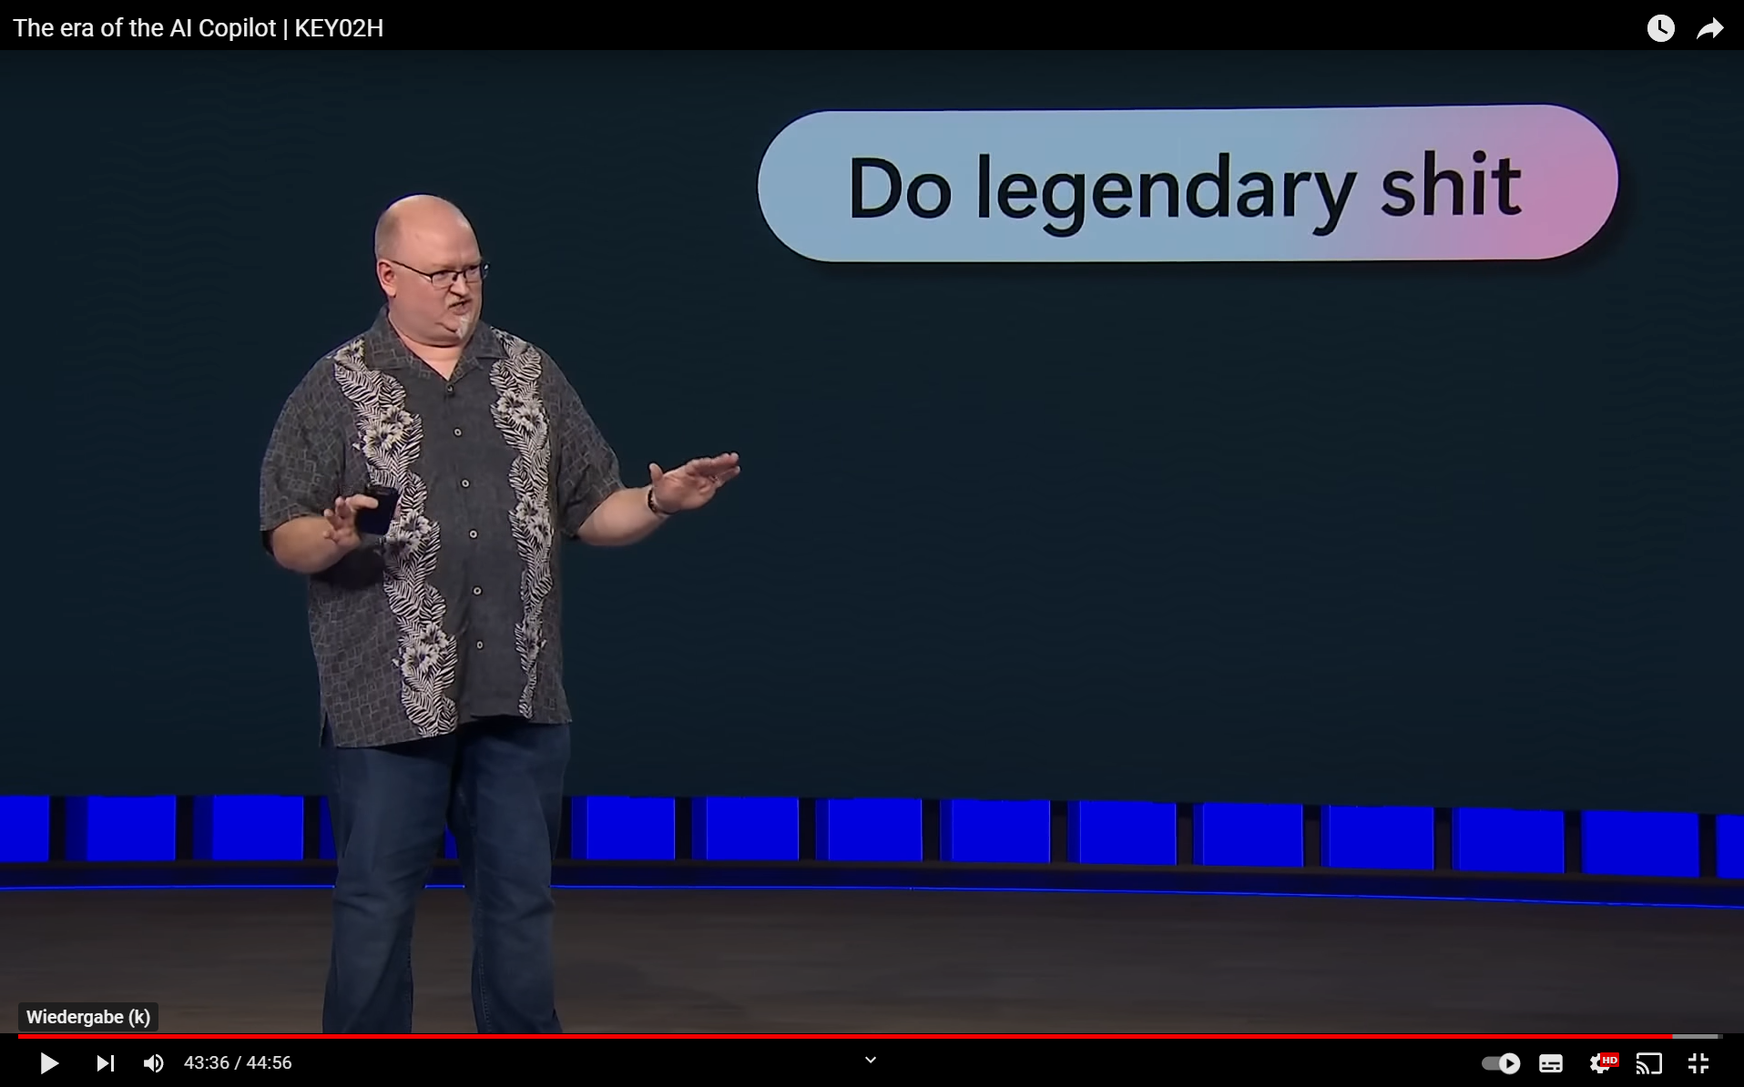
(Title)
(Body)

Slide 44
Icebreaker!

Slide 45
(Title)
(Body)

